Slide 1


PRESENTATION TO THE NIH ORS SAFETY COMMITTEE
April 23, 2014
Community Emergency Response Teams
Steve Peterson, President – Montgomery County CERT

Slide 2
Today’s Agenda
CERT Overview
Montgomery County CERT Overview
CERT Members’ Roles
Organizational Structure
Initiatives

Slide 3
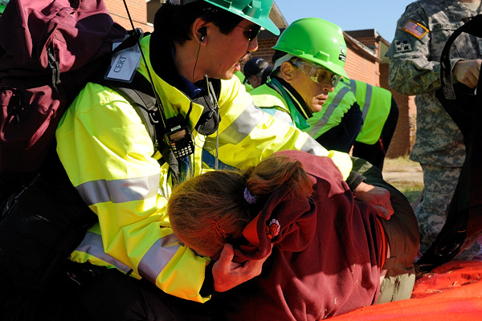
CERT Overview
Community Emergency Response Team (also Training)
Origin: Los Angeles Fire Department mid 80’s
FEMA made program available nationwide in the early 90’s
Provide critical assistance when professional responders are not immediately available
Implemented at the county level
ALL VOLUNTEERS
Notes:
The CERT program is an all-risk, all-hazard training designed to help you be ready to protect yourself, your family, your neighbors and your neighborhood in an emergency situation. Is a positive and realistic approach to emergency and disaster situations where citizens may initially be on their own and their actions can make a difference. While people will respond to others in need without the training, one goal of the CERT program is to help them do so effectively and efficiently without placing themselves in unnecessary danger.
February of 1985: A group of LA officials went to Japan to study its extensive earthquake preparedness plans.
September of 1985: A LA investigation team was sent to Mexico City following an earthquake. Volunteers are credited with more than 800 successful rescues; unfortunately, more than 100 of these untrained volunteers died during the 15-day rescue operation
1986: LA Fire Department developed a pilot program to train a group of leaders in a neighborhood watch organization.
1987: The Whittier Narrows earthquake demonstrated the need to expedite the training of civilians to prepare for earthquakes and other emergencies.
1993: FEMA decided to make the concept and program available to communities nationwide
2002:` CERT became part of the Citizen Corps, a unifying structure to link a variety of related volunteer activities to expand a community's resources for crime prevention and emergency response.
2011: All 50 states are using the CERT training.
Allows you to contribute to the safety and welfare of your family and community, and how to prepare your home and workplace for disasters.

Slide 4
Important Facts about CERTs
CERT Training and Safety
CERT members are trained to always keep themselves safe while helping others
They are not trained or equipped to handle incidents as professional responders.
CERTs Augment Response Resources
When response resources are taxed, they must focus on the highest-priority needs
This is where CERTs come in
Notes:
Follow your CERTs protocol for deployments/activations and self-deployments

Slide 5
Montgomery County CERT Overview
Celebrated our tenth anniversary in 2013
Received National award for Outstanding CERT Initiative (FEMA Individual & Community Preparedness Award)
Trained over 1,000 individuals
Currently have 500+ members
Recent deployment – Shelter Operations Support - Hurricane Sandy
Since August 2013, recorded 2,800+ volunteer hours associated to training, outreach, and operations (deployments)
Notes:
The Montgomery County (CERT) Program is managed by Montgomery County Fire and Rescue Service. Montgomery County CERT members are trained in basic disaster response skills. -fire safety, light search and rescue, team organization and disaster medical operations. They are prepared to provide critical assistance to others in their neighborhoods or workplace following an event when professional responders are not immediately available to help. Additionally, Montgomery County CERT members perform safety education and emergency preparedness projects in the community.

Slide 6
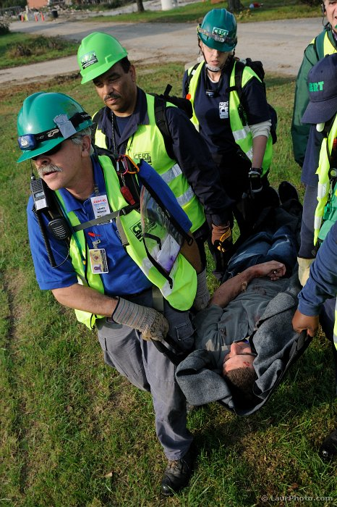
CERT Members’ Roles
Critical assistance during emergencies
Pre-planned events
Shelter Operations
Evacuations
SITREPs/Damage Assessment
Emergency preparedness programs
CERT Enhanced Training
Outreach
Storm Camp
Notes:
CERT members can give critical assistance to others in the community or workplace following an event when professional responders are not immediately available to help
CERT members also are encouraged to support emergency response agencies by taking a more active role in safety education and emergency preparedness projects in the community

Slide 7
CERT Organizational Structure
Program Manager, MCFRS
President
Vice President
Treasurer
Secretary
Outreach
Operations
Special Operations
Training
Storm Camp
Human Resources
Registrar
Social Media
Moulage
IT
CPR
Logistics

Slide 8
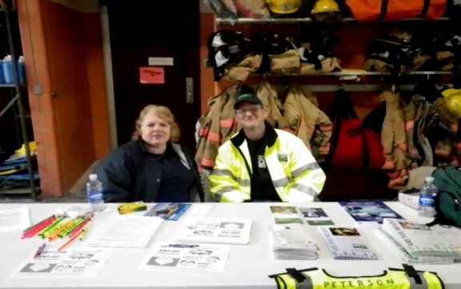
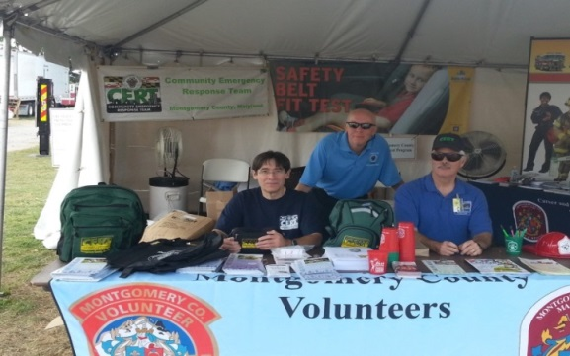
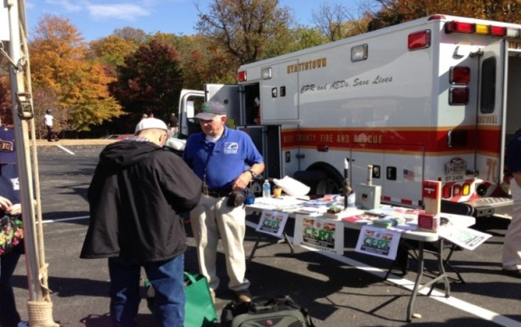
Outreach
Citizen Associations
Montgomery County Public Schools
Clubs
Boy Scouts/Girl Scouts
Notes:
Participation in different events as part of the group outreach effort are very common.
The goal is to open peoples mind to the importance of “being prepared” as well as to inform them about CERT and providing them with information about attending CERT Training sessions.

Slide 9
Operations
WHEN |  | WHAT
Dec 2003 |  | Creation of Montgomery County CERT
June 2006 |  | Support during Needwood Dam downstream evacuation
June 2006 |  | Support for Sligo Creek evacuation efforts
Feb 2009 |  | Inauguration 2009
June 2012 |  | Support for AT&T National Golf Tournament
Oct 2012 |  | Shelter Operations Support at three County shelters
March 2013 |  | SITREP and social media monitoring effort during snow storm
June 2013 |  | SITREP generating during 2013 tornado

Slide 10
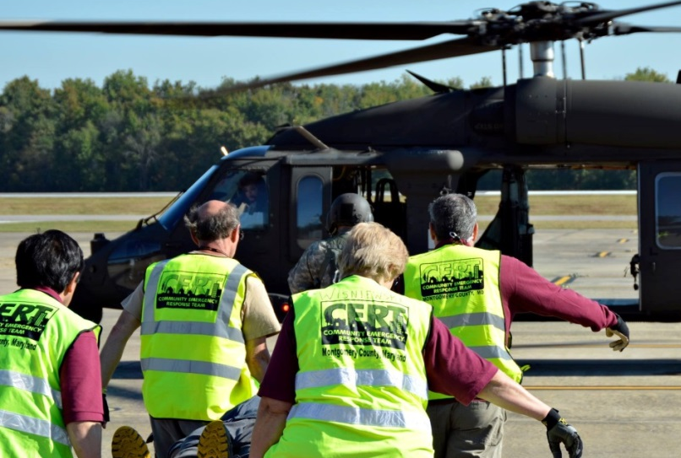
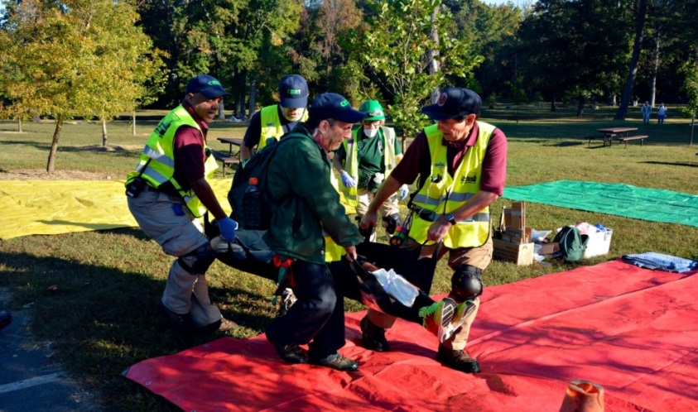
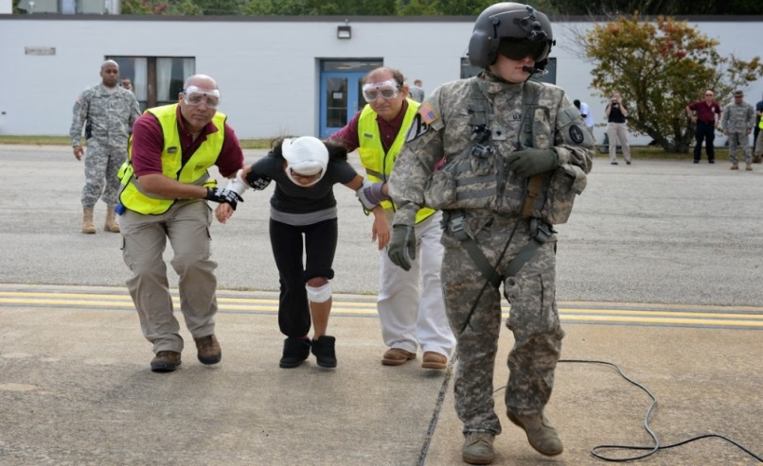
Special Operations
Exercises/Drills
Metro Exercise
Pre-planned events
AT&T Golf Tournament

Slide 11
Training
Since October 2013, the Montgomery County CERT volunteer management system has recorded 1,488 volunteer hours for 75 individuals (instructors and students) for 15 training events (3 of which were CERT Enhanced Training Classes)
The Montgomery County CERT Enhanced Training Program has trained over 1000 individuals since 2003
Seeks to attain additional instructors annually
Notes:
In addition to offering CPR as part of the CERT enhanced training, CERT offers Friends and Family Training on a quarterly basis

Slide 12
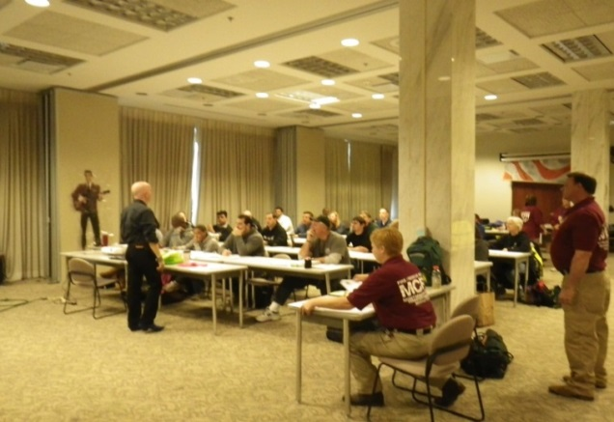
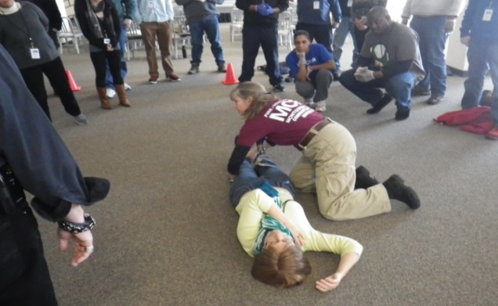
CERT Enhanced Training
Three sessions every year
30+ hours of training
Follows FEMA approved curriculum
Participants receive a basic CERT kit
Open to all County residents
Notes:
3 sessions/year Winter – Fall - Spring
Five weeks, twice a week. One week night and one morning or afternoon during the weekend. For a total of 30 hours
A typical schedule would be one weekday evening from 7-9 pm AND four hours on the weekend (for example 9am – 1pm on a Saturday, or 12:30pm – 4:30pm on a Sunday).
Disaster Preparedness, Damage Assessment, First Aid, Triage, FRS Radio Use, Fire Safety / Fire Extinguisher Usage, Light Search and Rescue, Hazardous Materials Awareness, Incident Command System (NIMS), Pet Safety, Terrorism Awareness, and Mass Casualty Response.
Basic Kit: Backpack with Helmet, Special Multifunction Tool, Googles, Gloves and other tools.
Montgomery County CERT caters to residents of the county who are at least 18 years of age. Exception can be made for people who work within Montgomery County boundaries. As of this writing, this valuable opportunity is being provided to residents at no cost other than a participant’s commitment and desire to learn.

Slide 13
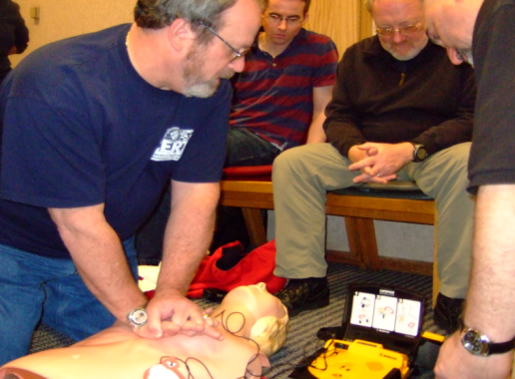


CERT Enhanced Training Curriculum
Fire Extinguisher/ Fire Safety
Disaster First Aid/ Triage (RPM)
Mass Casualty Operations
Light SAR
Lifts and Carries
Damage Assessment
Haz Mat Awareness
Disaster Psychology
NIMS & ICS
Basic Radio Procedures
CPR/AED
Upon completion, participants may apply to become CERT members and after passing a background check they will receive a CERT ID card and an official MC CERT vest, and be “deployable”
Notes:
This training will allow graduates to respond to the immediate need of their community in the aftermath of a major disaster - the time when emergency services may not be immediately available.
By working together, CERT members can assist in saving lives and protecting property by implementing the basic techniques taught in this course.

Slide 14

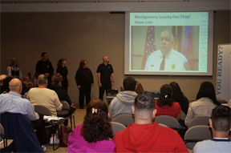

Storm Camp - NEW!
Half Day, interactive, for adults and children
How to prepare a Home Disaster Kit
A special program (“Ready Pirates”) for kids under 12
Program successfully kicked off March 29th
Notes:
Storm Camp will show you how to prepare your home and loved ones for emergencies large and small. You'll learn how to build a Home Disaster Kit, how to safely operate a fire extinguisher, how to respond to common life threatening medical emergencies, and how to organize your neighborhood and workplace to be ready. Kids under 12 will enjoy a special program of fun and learning that will turn ordinary youngsters into "Ready Pirates" equipped with age appropriate emergency skills.
Storm Camp is a 3 1/2 to 4 hour long interactive event for groups of 50 or more presented by the Montgomery County Community Emergency Response Team (CERT). Storm Camp is presented by FEMA certified instructors who are made up of active and retired EMT's and Firefighters.
To learn more or to request a Storm Camp for your group please submit your request via http://montgomerycert.org/training/ or send an email to Registrar@montgomerycert.org
http://montgomerycert.org/storm-camp/

Slide 15
Human Resources and Registrar
Human Resources
Provides onboarding procedures
Processes trainees’ paperwork
Sets up appointments for fingerprinting/badging
Ensures proper paperwork completed
Registrar
Initial CERT point of contact for trainees’
Communicates training schedule with potential trainees
Ensures attendance at each training session
Enters trainee data into volunteer management system
Works closely with the Human Resources Coordinator

Slide 16
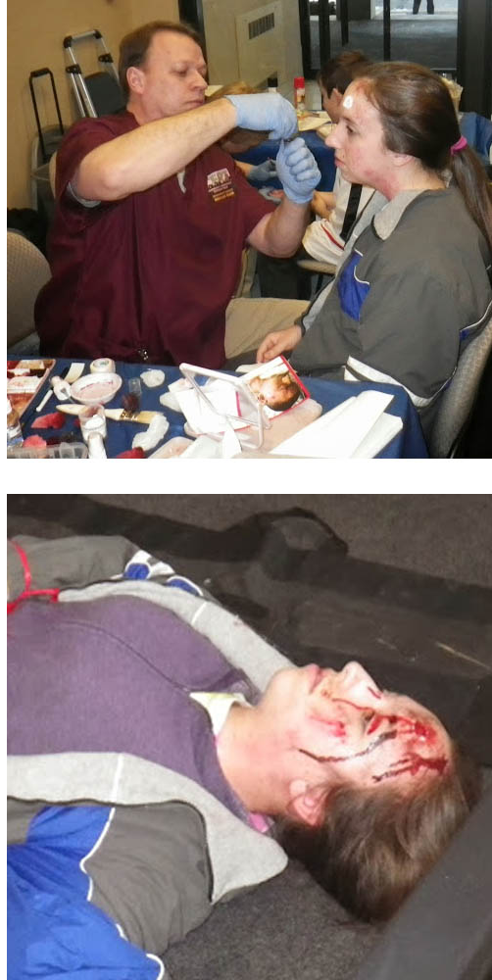
Moulage Team
Seven professionally trained Moulage technicians with the abilities to sculpt, mold, and cast own customized appliances
Capable of performing full range of injuries seen in vehicle collisions, industrial accidents, shootings, building collapse, search and rescue scenarios, natural disasters and combat type injuries such as those caused by improvised explosive devices (IED) and more
Moulage 6-10 times per year and with number increasing as more regional events learn of our talents
The number of "victims" at the exercises and training scenarios range from 30 to 150

Slide 17


Information Technology & Social Media
Information Technology plays a critical role in CERT
Website
Volunteer Management System
Email
Security
Social Media
Established in late 2012
Utilizes multiple social media platforms to promote preparedness awareness

Slide 18
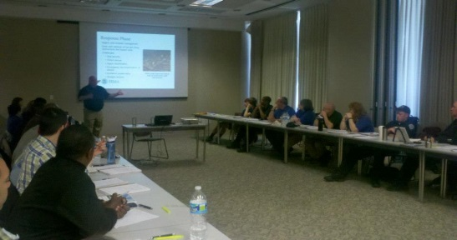
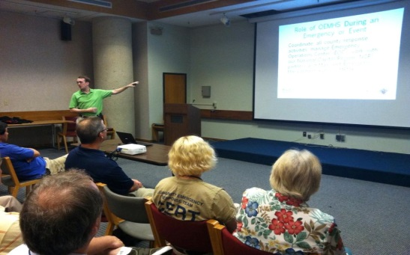
Strategy: Retaining Members
Service offerings to CERT members
Continuous training
Specialized training
Psychological First Aid Training
Active Shooter
Training at monthly general meetings
Drills and Exercises
Notes:
Members may attend additional training and/or “refreshers” sessions as well as lectures from experts.
Examples:
Hazardous Materials
Metro (WMATA) security
Use of Dogs in SAR activities
Active shooter
Power issues during emergencies
They also participate in multi-jurisdiction and multi-agencies drills/exercises.
CERT CON (Wash. Metro Area CERT and F&R agencies)
CapShield (Wash. Metro Area CERT and United States Army)

Slide 19
Initiatives

Slide 20
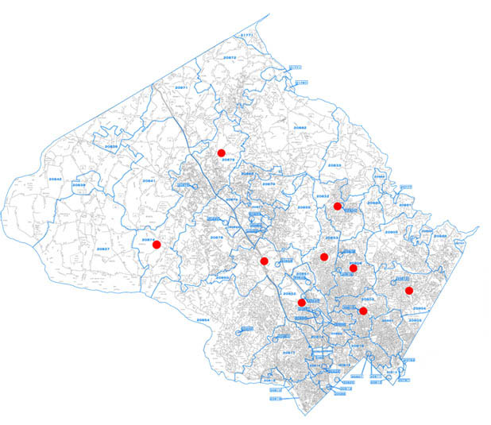
Situation Reports (SITREPs)
CERT members developed 29 SITREPs from home
Provided a comprehensive picture of weather conditions
SITREPs were readily available for decision makers within the EOC
Notes:
As noted before, we have an ongoing initiative associated to collecting SITREPs from our members who have mobile devices and access to the Internet.
Before I go any further, the graphic you see here is a map of Montgomery County, Maryland where our members live
The red dots represent the zip codes where SITREPs were generated during the March 6, 2013 snow storm. We performed this initiative simultaneously while providing social media monitoring support within the EOC. Do you see the value here? SITREPs coming into CERT POCs within the EOC? Real-time situational awareness from credible sources?
Let me give you a little background on this initiative:
The original purpose behind it was to test the effectiveness of sending and capturing SITREPS during an actual emergency utilizing mobile devices. With that said, we sent a message within 48 hours of the storm to all 400+ CERT members of Montgomery County. We developed a template that sought specific information. The template sought first, at what time did they generate the report, then it asked what zip code did the reside in, did they have power at their home (and yes, you can still communicate on your mobile device without power to your home provided you have a charge left on your device), how were the road conditions in their community (i.e., plowed?); were there any obstacles on their property or within site (e.g., trees down). Members of CERT were requested to observe the weather conditions from the safety of their home.
By the end of the snow storm and consolidating of received SITREPs, we had received reports from 9 different zip code zones in the county.
Although this was a separate effort to the social media monitoring effort, it still proved the two initiatives could be tied together in future emergencies if we had a CERT member present within the EOC who could relay the consolidated SITREP information to the EOC manager.
We were impressed by the number of contributors to this initiative given it was a last minute request of membership. Their responsiveness was excellent. Again, we asked members to provide their assessment from home. We also encouraged, but did not require, photographs. 40% of our reports contained photos. Note, if you are interested in performing a similar initiative in your agency, I would recommend you instruct your colleagues to be conscientious of the file sizes they are sending via email. 5MB images of snow in one’s front yard is not that advantageous. Instruct your colleagues to reduce the file size before sending otherwise you bog down your bandwidth.
In addition to templates allowing for consistency in reporting, they provided us the ability to easily develop a comprehensive SITREP and to generate statistics that could be used in real-time during the storm as well as for after action reports. Again, we were impressed by the number of SITREPs generated on such short notice. Since we performed this first initiative, we have repeated it eight times – 7 snow storms and 1 EF-0 which occurred in June 2013 (with 75 mph) whose path length was 17.3 miles according to the National Weather Service

Slide 21
2014 CERT SITREP Participation
125
113
83
Number of SITREPs
32
Tues, Jan 21
Mon, Feb 3
Thurs, Feb 13
Mon, Mar 3
Notes:
The first couple months of 2014 have been busy with performing SITREPs. We are excited to see the participation from our newest CERT graduates as well as CERT members that had not previously engaged in this valuable initiative. We concluded that the increase in the number of participants for several of the storms had to due mainly with the magnitude of the storm. For example, we had between 5 and 8 inches of snow with the January 21st snow storm, and we had between 13 and 18 inches of snow with the February 13th snow storm.
I wish to highlight several observations from our two largest SITREP efforts that occurred this year:
For the January 21st snow storm:
113 SITREPs received in the fourteen hour span, 42 were received in the first five hours of the snow storm, accounting for 37% of all SITREPs received. As the snow picked up, as the forecasted predicted, the next five hours of receiving SITREPs saw the largest percentage of contributions – 42% (49 SITREPs)
The final four hours saw the lowest amount of contributions as the storm had subsided and the announced deadline of 11:00pm approached
Over 20% of Montgomery County’s zip codes were represented in the 113 SITREPs from CERT members
For the February 13th snow storm:
125 SITREPs received . 31 SITREPs (25%) contained pictures and 40 CERT members contributed – largest amount of contributors ever
32% were unique (aka - not the same contributor) – lower than past contributions but this may be in part due to the large amount of SITREPs received
There were no reports of power outages
SITREPs for past three major snow storms have steadily increased (85 SITREPs with the Dec 8 2013 storm (not shown here); 113 with the Jan 21st storm; and 125 with the Feb 13th storm)

Slide 22




Social Media Monitoring: How It Worked
2
CONSOLIDATION & VERIFICATION
provided verified
info for
ACCURATE DISSEMINATION
Posts
Posts
ReTweet
ReTweet
ReTweet
ReTweet
Tweets
Tweets
Tweets
Tweets
Authoritative Tweet
Authoritative Tweet
ReTweet
ReTweet
ReTweet
ReTweet
Posts
Posts
3
ReTweet
ReTweet
CONSOLIDATION & VERIFICATION
ACCURATE DISSEMINATION
1
4
GENERAL PUBLIC
COMMUNICATIONS
AGENCY
COMMUNICATIONS
GENERAL PUBLIC
COMMUNICATIONS
GENERAL PUBLIC
COMMUNICATIONS
GENERAL PUBLIC
COMMUNICATIONS
AGENCY
COMMUNICATIONS
Notes:
So, at 5:30am, we arrived at the EOC to prepare for its activation at 6:00am.
This is how it worked, during our two shifts, from our desktop location in the EOC. We monitored both Facebook and Twitter through our Montgomery County CERT accounts
Phase 1:
We used a Social Media Management Dashboard to search hashtags and generate search strings. We extracted valuable links from posts and tweets, generated an archive of hashtags that were prominent during the snow storm, continued to increase our list of followers as they appeared online with valuable information, reviewed the content for accuracy and consolidated information.
Phase 2:
After having weeded out the noise, we took the consolidated information and shared it with EOC officials
Phase 3:
During this phase, the EOC officials could decide whether to post information on social media platforms based on the information we provided. If they elected to do so, the message that was crafted would have been done through the agency’s official Twitter account – not Montgomery County CERT – we were to remain transparent.
Phase 4:
Now, with EOC officials having verified information from a trustworthy source, they were able to develop solid posts and tweets and communicate on social media platforms thus ensuring accurate information was being disseminated by an authoritative source and ultimately shared by public which in turn ensures accurate information gets distributed and potentially eliminates rumors or clarifies reports. Case in point, the marina fire could have used a report by the official agency early on in the fire, when social media reports by the public were being spread indicating that homes were on fire. Had the agency (or someone from the EOC) been monitoring social media during the emergency, they could have clarified the intensity of the fire and that no homes were involved.

Slide 23
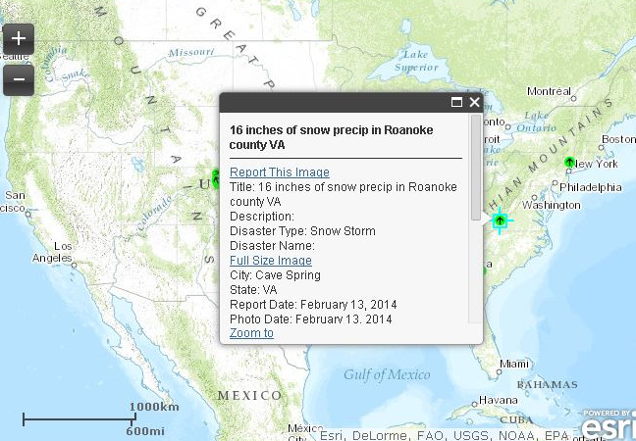
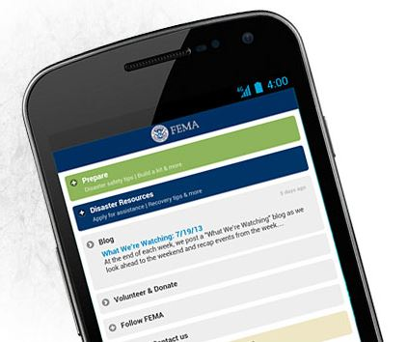
Potential Initiative:
FEMA Disaster Reporter App

Slide 24
Next General Meeting
Please join us for our next general meeting on May 8th
Executive Office Building Auditorium
101 Monroe Street
Rockville, MD 20850

Slide 25
Key Takeaways
With proper CERT training, you can help protect your family, neighbors, and co-workers if a disaster occurs

Slide 26
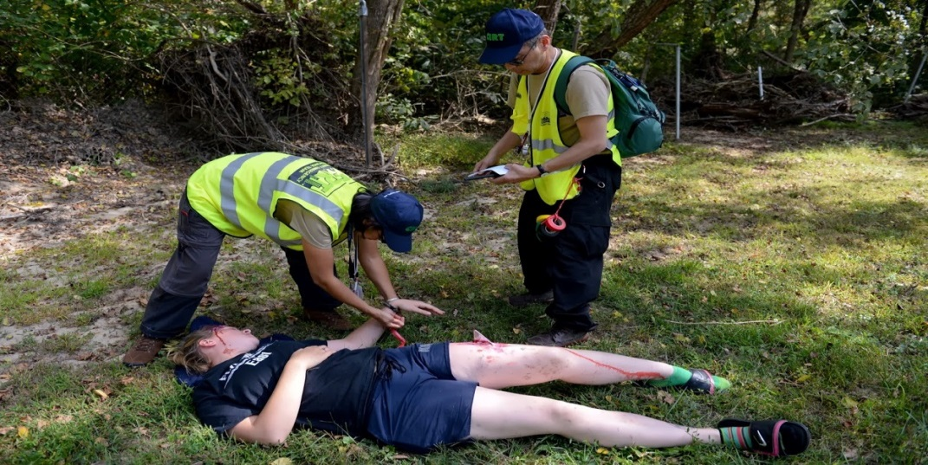
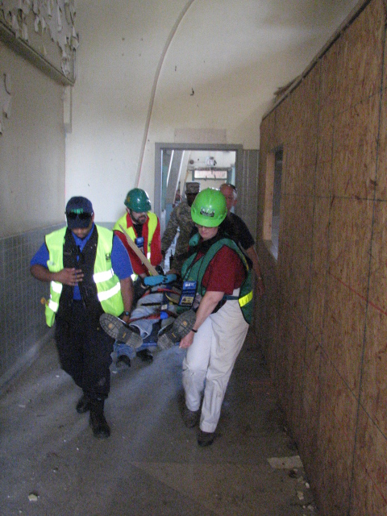
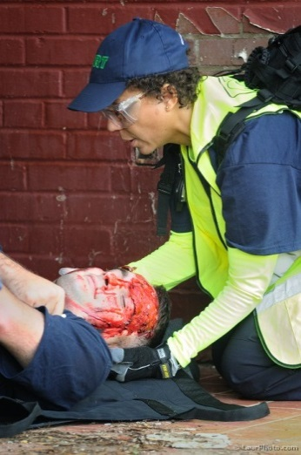
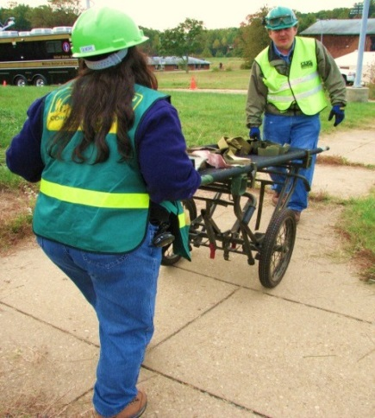
CERT – Ready to lend a hand!

Slide 27
Thank you

